Slide 1
TRAIL APPS FOR EQUESTRIANS
Peninsula BCHW August 2022

Slide 2
Chrissy Williams, Pat Cosner, Sue Turner, Pat CP
https://www.gaiagps.com
“I use Gaia. Works without service and has a ton of layers like snow depth, snow forecast, timber cutting, private property to just name a few. I pay for the premium version that is $40 a year.”
“GAIA is the one I always use, as it's only $20 a year, is always accurate, is pretty user-friendly, and you can use it on airplane mode to save your phone's battery. Best of all, I've found that it works everywhere.”

Slide 3
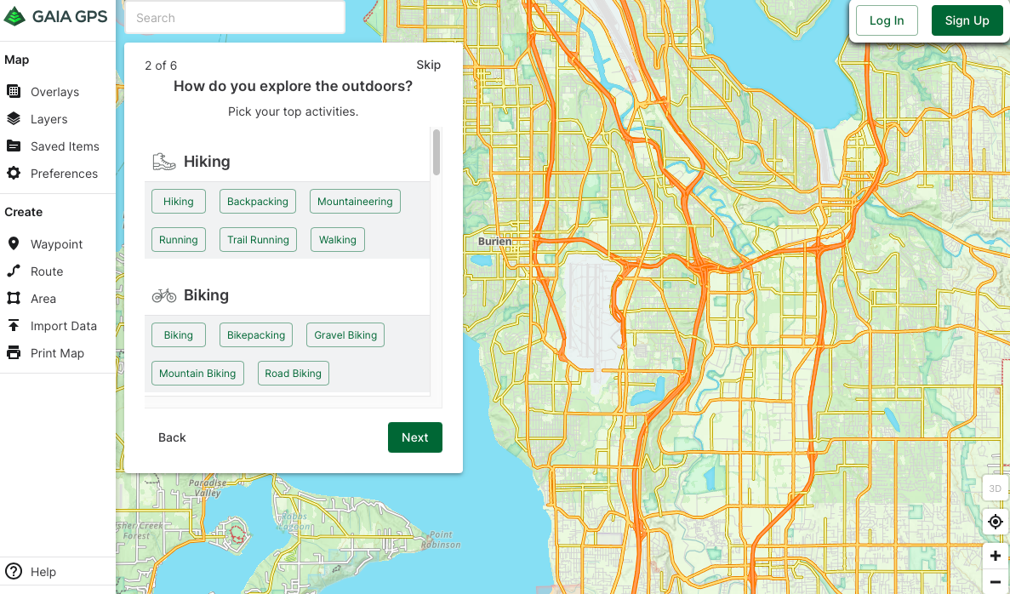
Scroll down to ‘other’

Slide 4
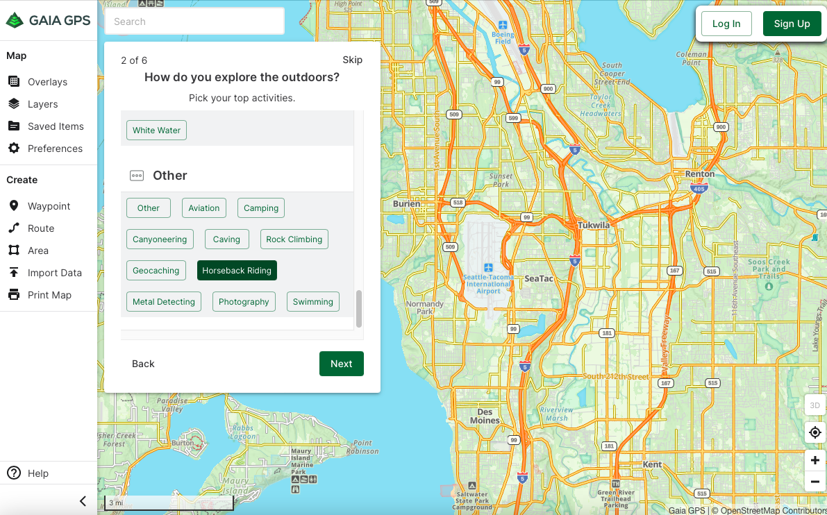
Under ‘Other’, choose horseback riding

Slide 5
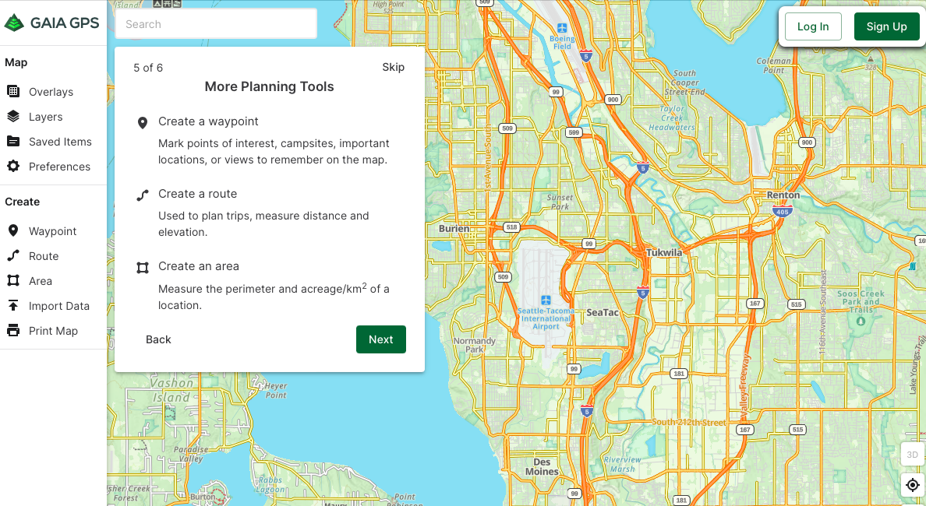
Use more planning tools

Slide 6
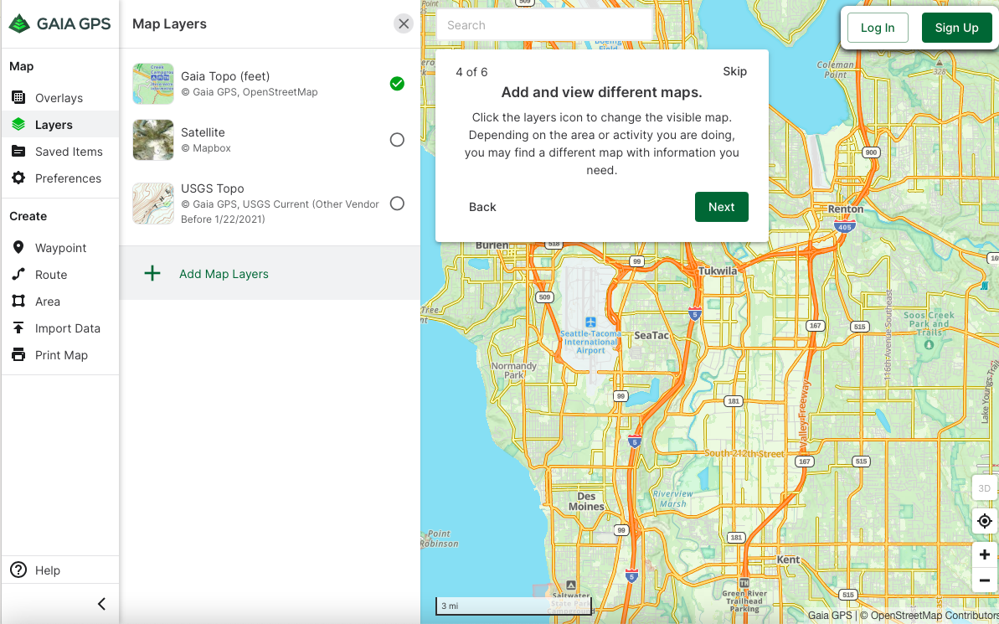
Choose map layers

Slide 7
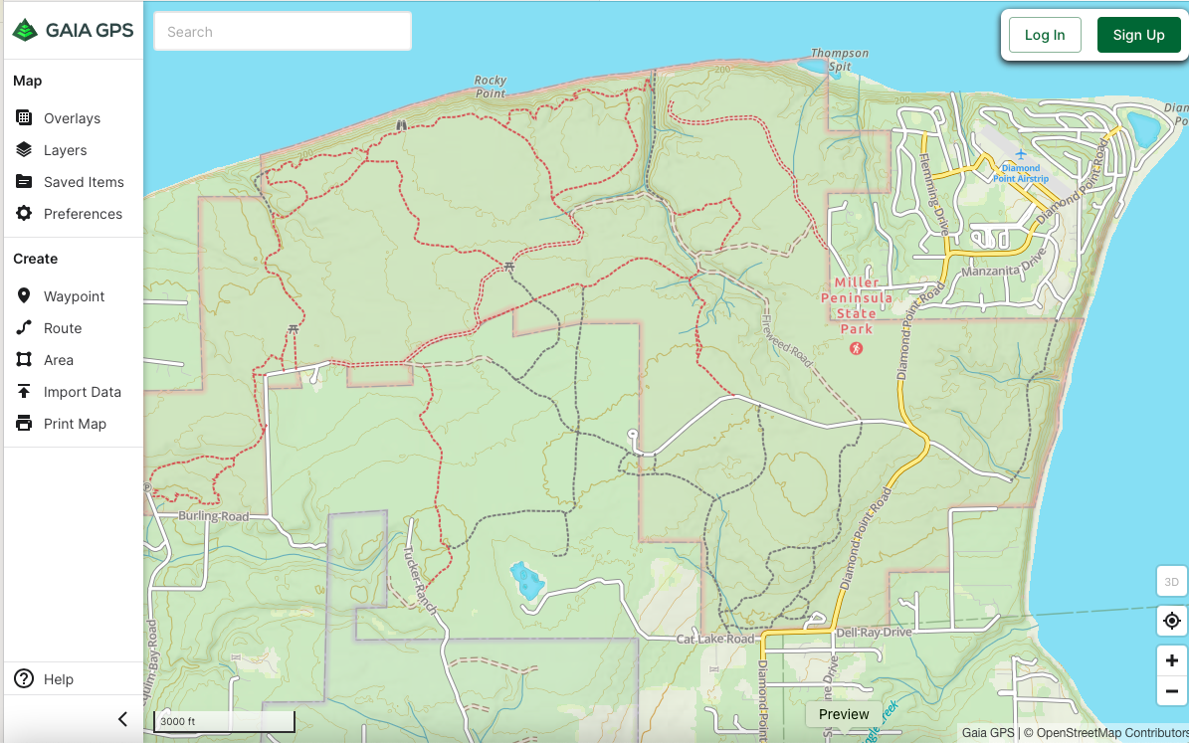
Miller Peninsula map

Slide 8
Wendy Inman
“I use OnX Hunt. I love it. It shows property boundaries, roads, and who owns property. You can also select portions of the map to use offline.”
https://www.onxmaps.com

Slide 9
Onx hunt

Slide 10
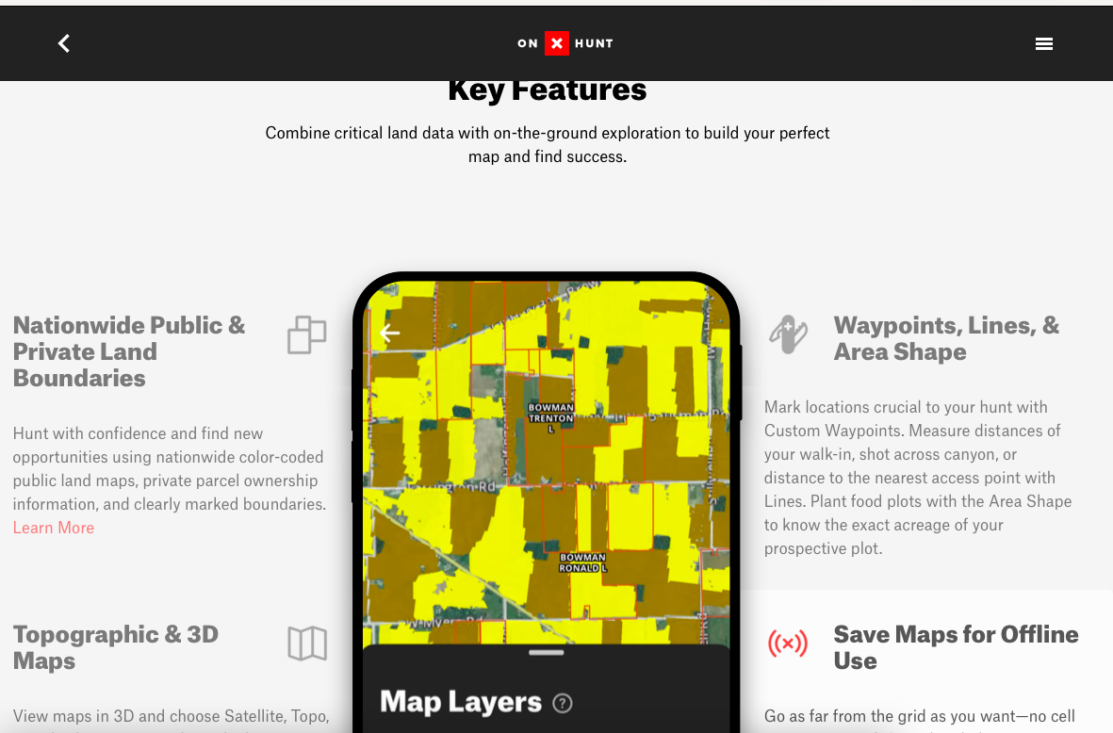
Onx hunt

Slide 11
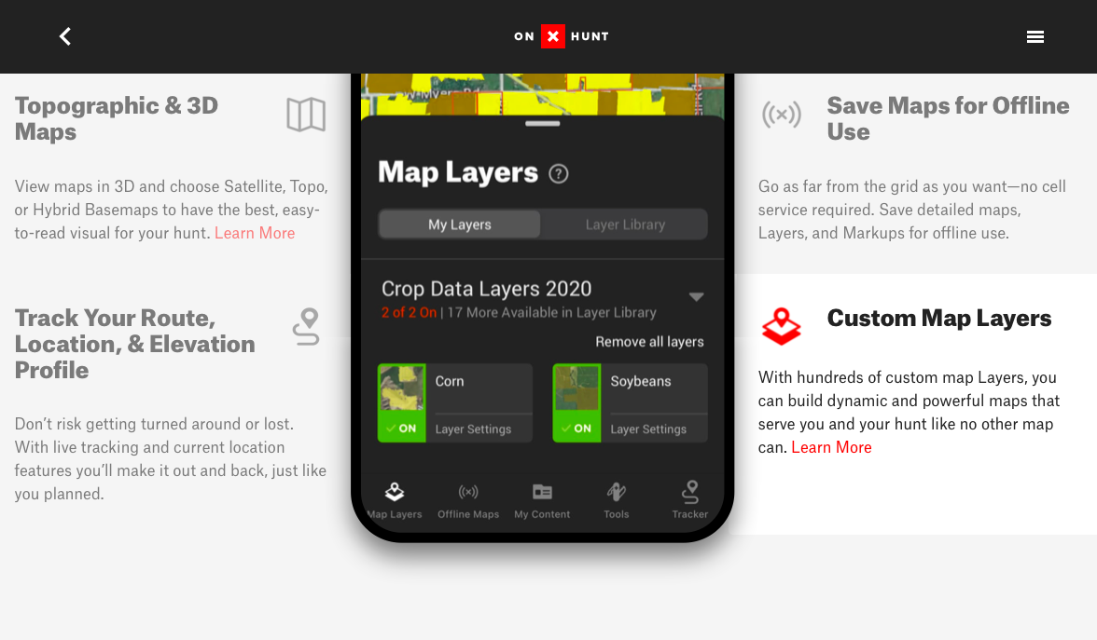
Onx hunt

Slide 12
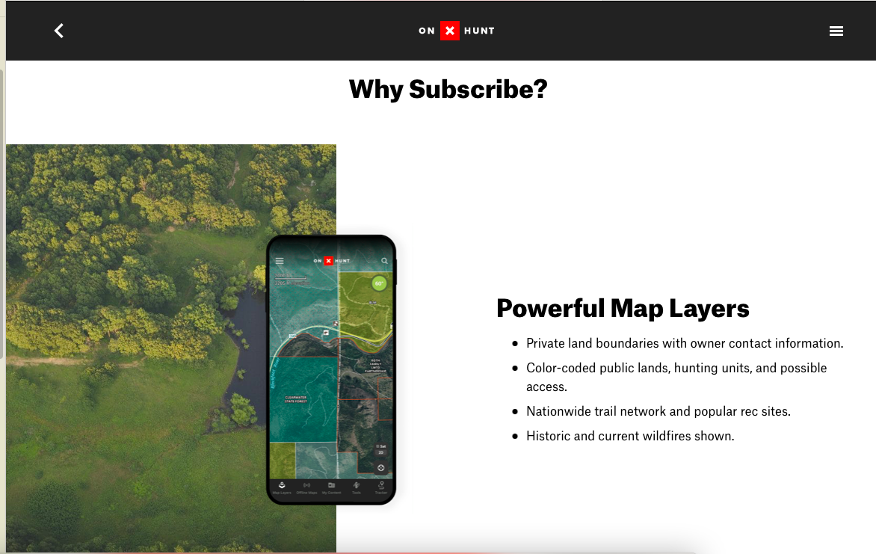
onx hunt

Slide 13
Onx hunt

Slide 14
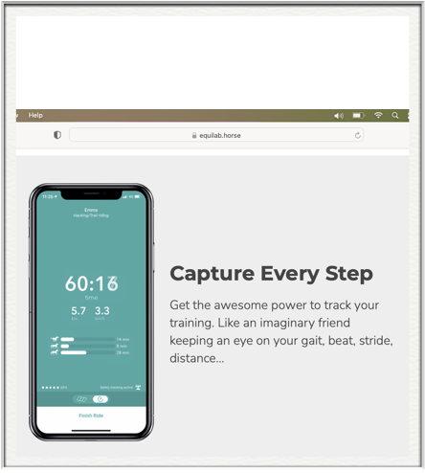
Stephanie Burns
https://equilab.horse
Records your route, mileage, speed and gaits.

Slide 15
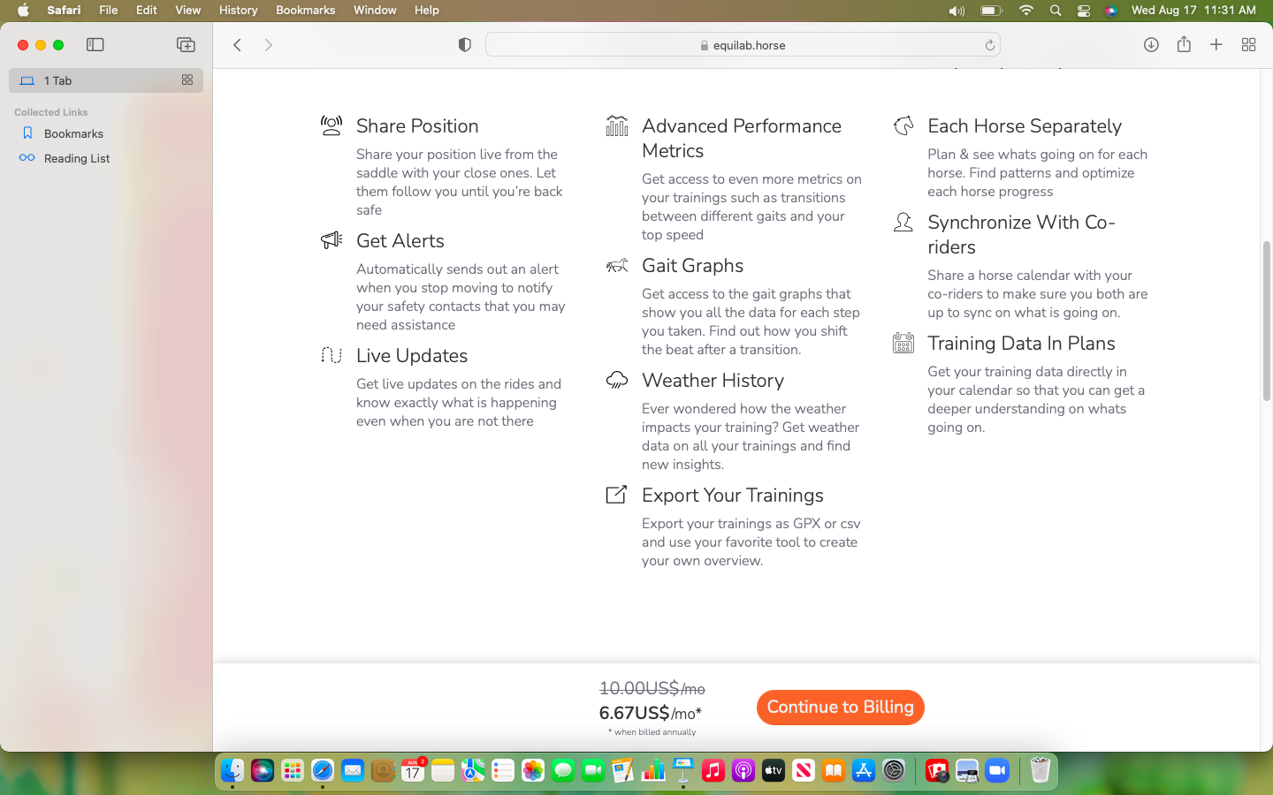
Equilab - they’re from Sweden

Slide 16
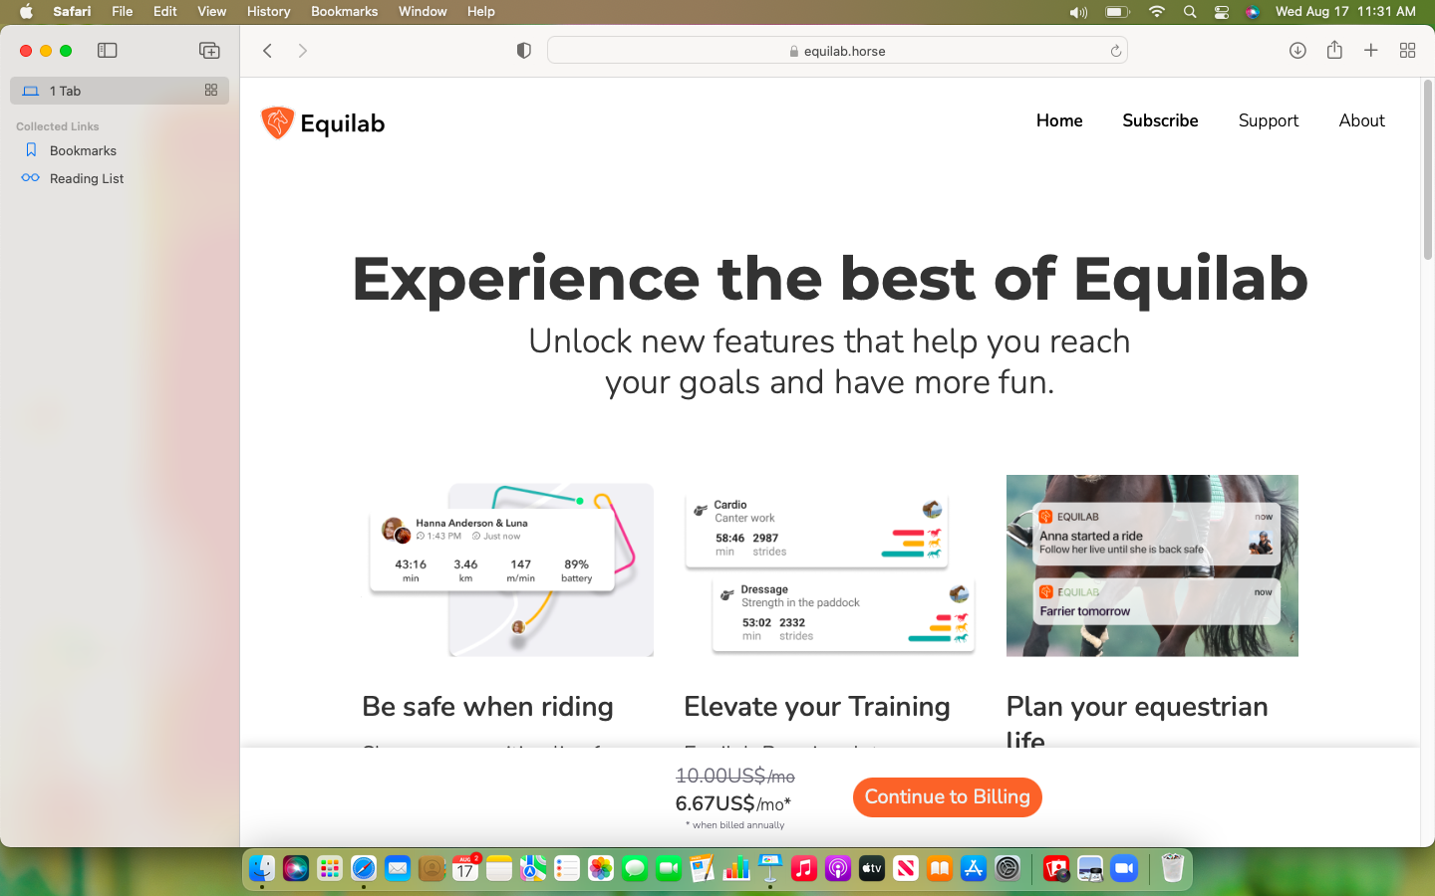
Equilab

Slide 17
Equilab

Slide 18
Equilab

Slide 19
Anyone else?

