Slide 1
My Favorite Olympic Peninsula Trails
Tom Mix

Slide 2
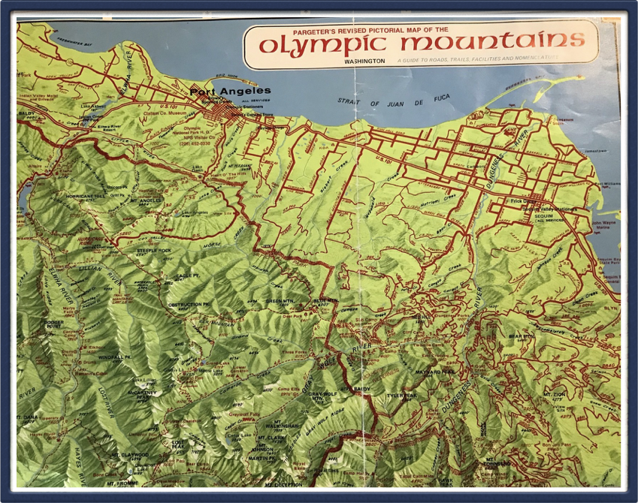
Olympic Peninsula Map
Tubal Cain Trail

Slide 3
Tubal Cain Trail #840 to Boulder Shelter
7 miles out & back
Easy to moderate, has water crossings
3,000 ft gain
Stock need shoes
Go in early Summer
No Fee, Wilderness rules apply
No Facilities
Don’t pull into Tubal Cain Parking lot - go past it and turn around, come back and park along the side of the road below the parking lot

Slide 4
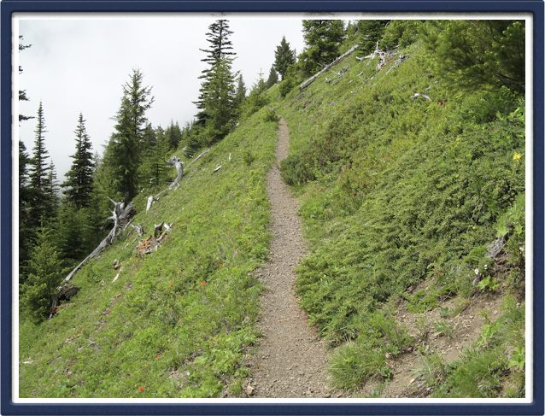
Tubal Cain # 840
This bench needs work!

Slide 5
Upper Dungeness
#833 to Boulder Shelter

Slide 6
Upper Dungeness #833 to Boulder Shelter
8 miles
Moderate to difficult
2,500 ft gain
Concrete Bridge, turnpike, Royal Creek Ford
Stock need shoes
Go weekdays June to October
$5 per vehicle/day or NWF Pass
Trailhead with trailer parking,
(back in to hitch rails)
Park end to end on weekends

Slide 7
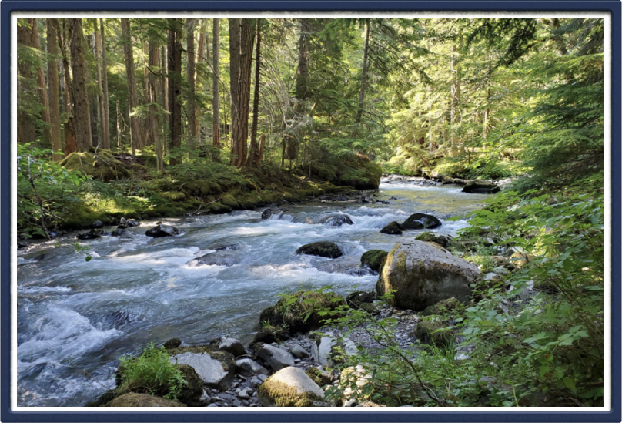
Trail #833 along the Dungeness River

Slide 8
Tubal Cain to Upper Dungeness
Loop Over Buckhorn Pass
Flowers, sub-alpine meadows, view into the Olympics

Slide 9
Loop from Tubal Cain # 840 over Buckhorn Pass
to Upper Dungeness # 833
15 miles
Moderate
Up to 3,500 ft gain
Some scree slopes, water crossings
Stock need shoes
June - November
NW Forest Pass
Multiple Camping areas if desired
(Boulder shelter,)

Slide 10
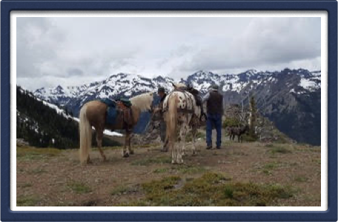
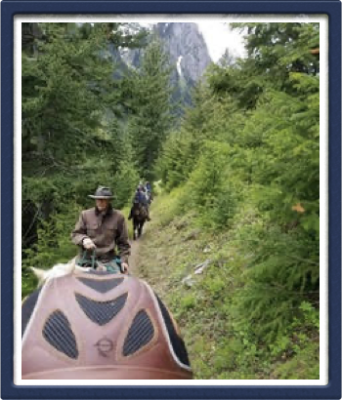
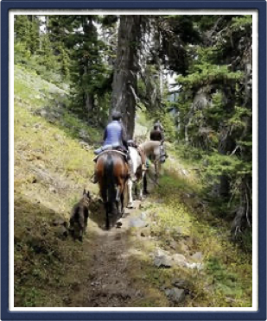
Buckhorn Pass

Slide 11
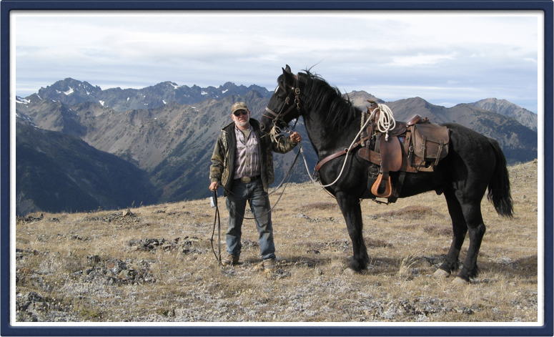
Top of Buckhorn Pass
With Del Sage and Rocky

Slide 12
Dosewallups

Slide 13
Dosewallups River Trail to old Ranger Station
5.5 miles one way
Moderate
800 feet gain
Stock need shoes
Go May-October
No fee (ONP)
Great camping, great stock feed, and trees
for high lining
Park heading out for best results
Needs better trailer parking at trailhead

Slide 14
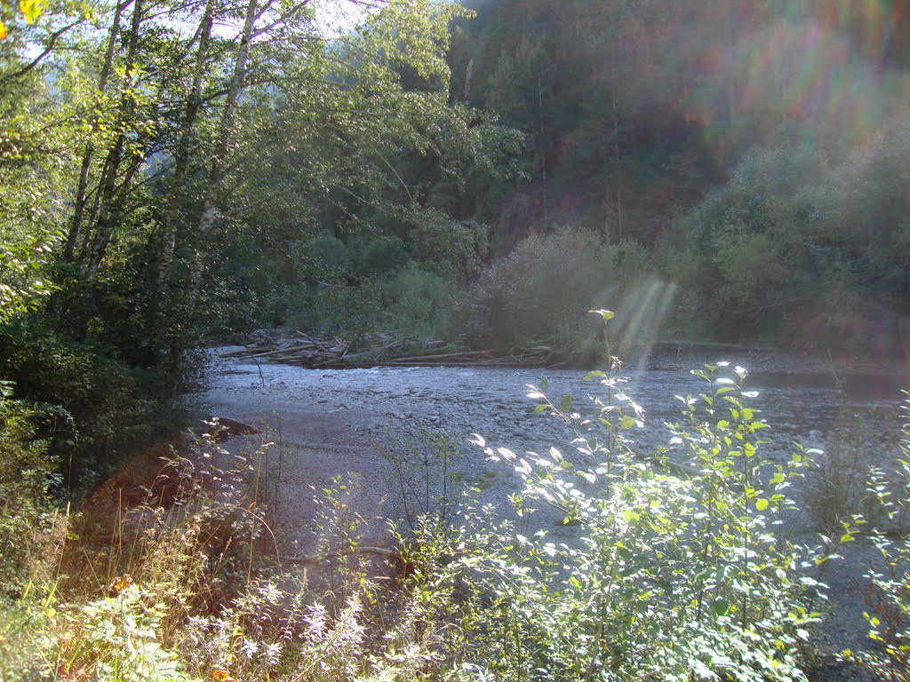
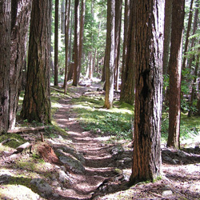
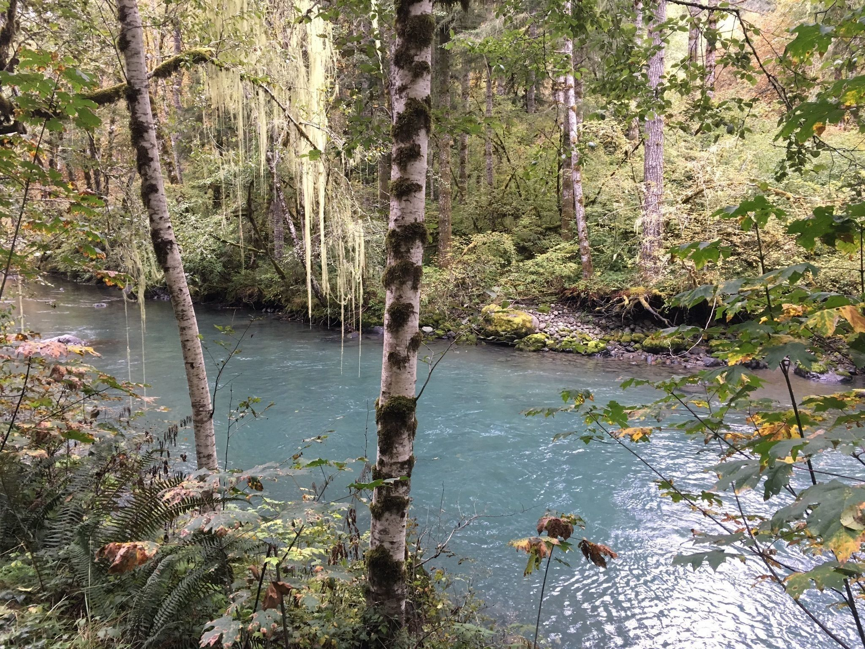
Dosewallups
River Trail

Slide 15
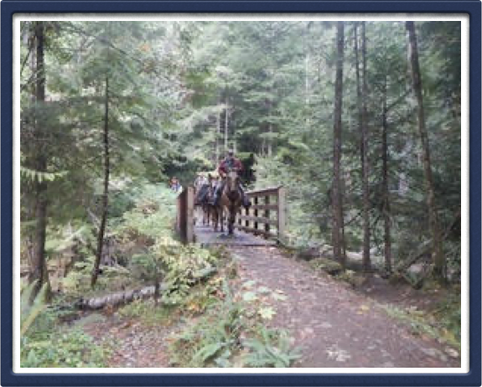
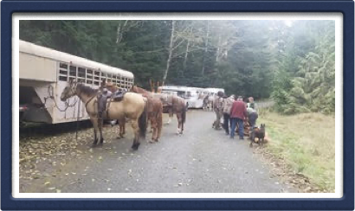
Dosewallups & Lower Big Quilcene

Slide 16
Striped Peak Trail at Salt Creek
Salt Creek Recreation Area

Slide 17
Ride Counter Clockwise to Freshwater Bay Road.

Slide 18
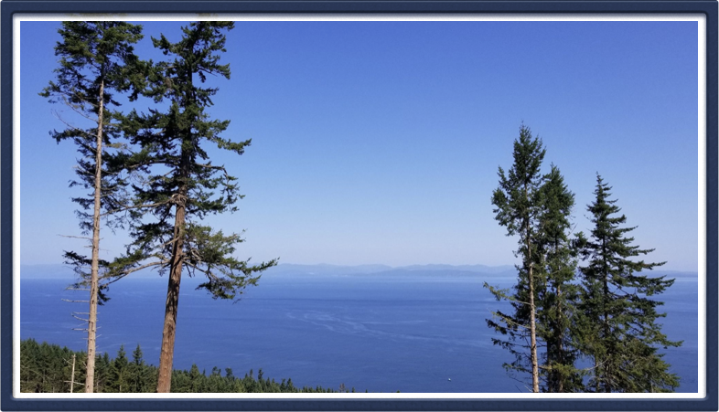
View from Striped Peak

Slide 19
Striped Peak
6.1 miles
Easy-moderate
1,000 ft gain
Stock needs shoes
Year round, weather permitting
No fee (DNR)
Trailer parking is near the Salt Creek County Park entrance

Slide 20
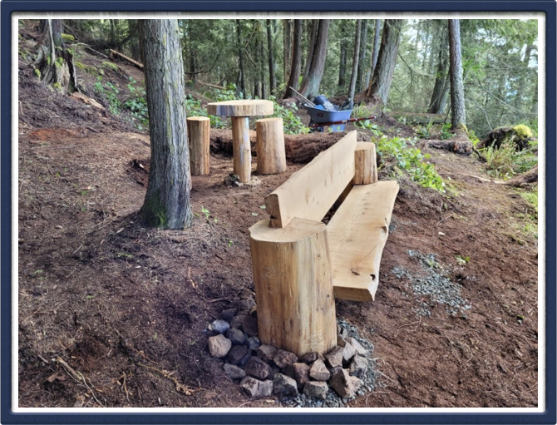
Rest a Spell at Striped Peak

Slide 21
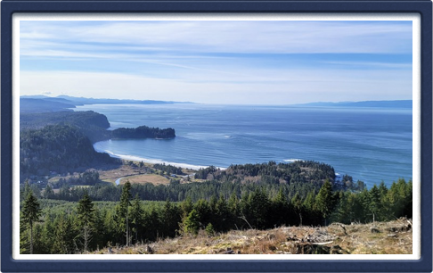
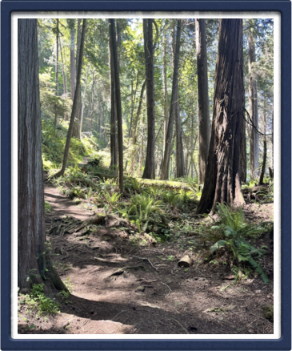
The Strait Slope section of the trail is
closed to stock until Fall of 2022

Slide 22
Are You Ready?
Where can you practice some
skills for these rides?

